Slide 1
How to read a
research paper
Asynchronous video slides Manasi Jayakumar
Slides adapted from a SIPPS 2022 workshop co-taught with Claudia Espinoza-Heredia

Slide 2
Lesson Plan
What does a research paper look like?
Important parts of a research paper
Taking notes on a research paper
Some tips for reading papers
Notes:
What does a research paper look like?
Important parts of a research paper
Taking notes on a research paper
Example of a paper breakdown

Slide 3
What does a research paper look like?
Empirical papers
Original experiments or data analysis
Sections:
Abstract
Introduction
Methods
Results
Discussion
Review papers
Summary and evaluation of papers that have been published in the field
Present:
Theory or theoretical framework
Gaps in knowledge and suggestions for future research
Notes:
Empirical papers:
Papers that describe original experiments or data analyses conducted by the authors
Typically have sections such as Abstract, Intro, Methods, Results, and Discussion (though not necessarily always in that order)
You’d see these common phrases:
“We tested…”
“We measured…”
Review papers:
Papers that summarize and evaluate the research papers that have been published in the field.
Present:
Theory or theoretical framework
Gaps in knowledge and suggestions for future research.
You’d see these common phrases.
“We review evidence from X, Y, Z”
“Our overview includes …”

Slide 4
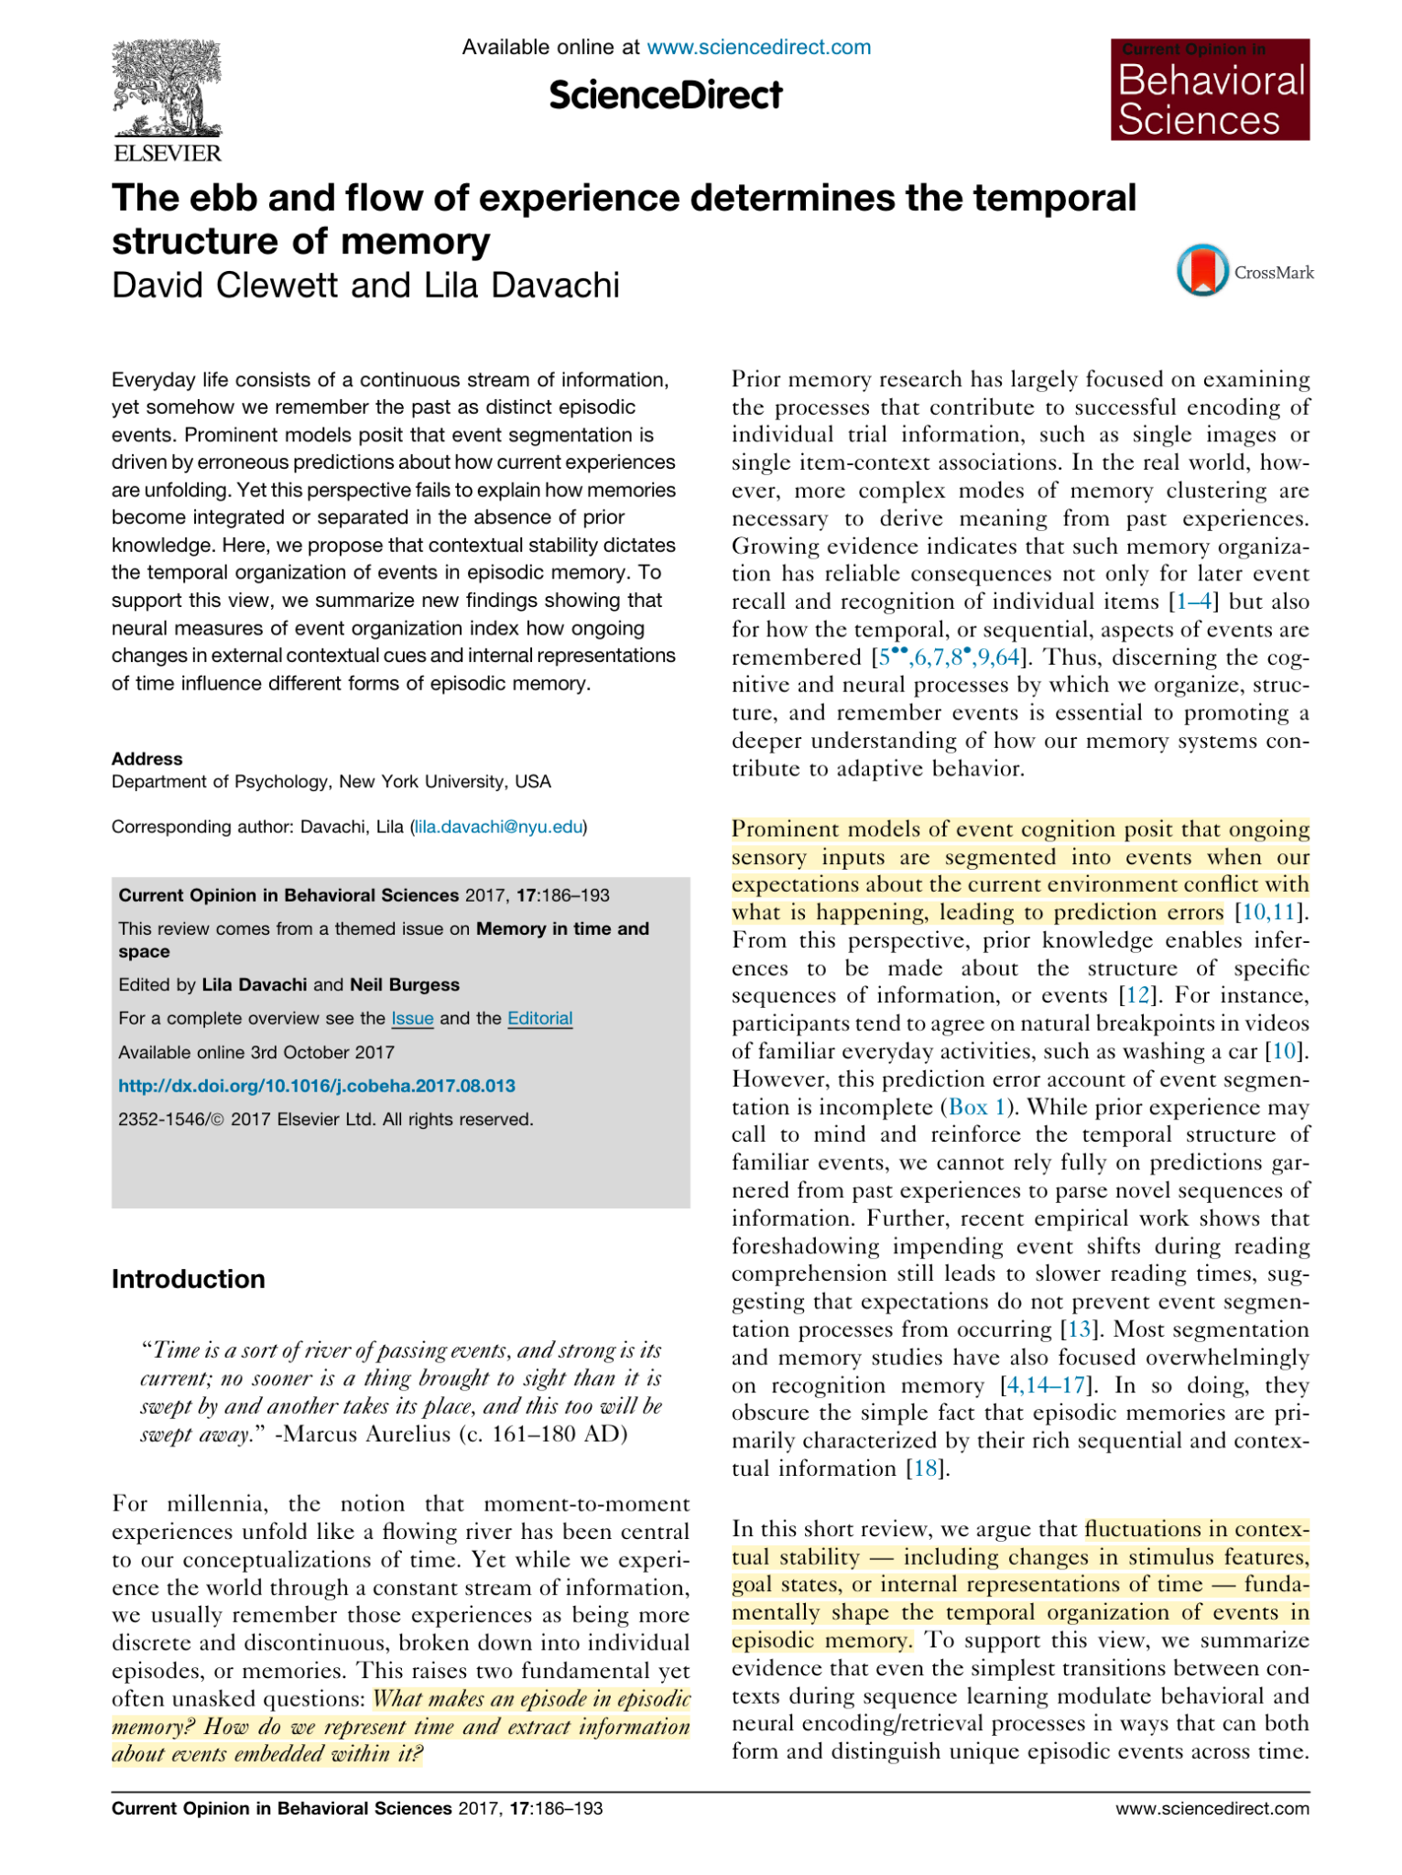
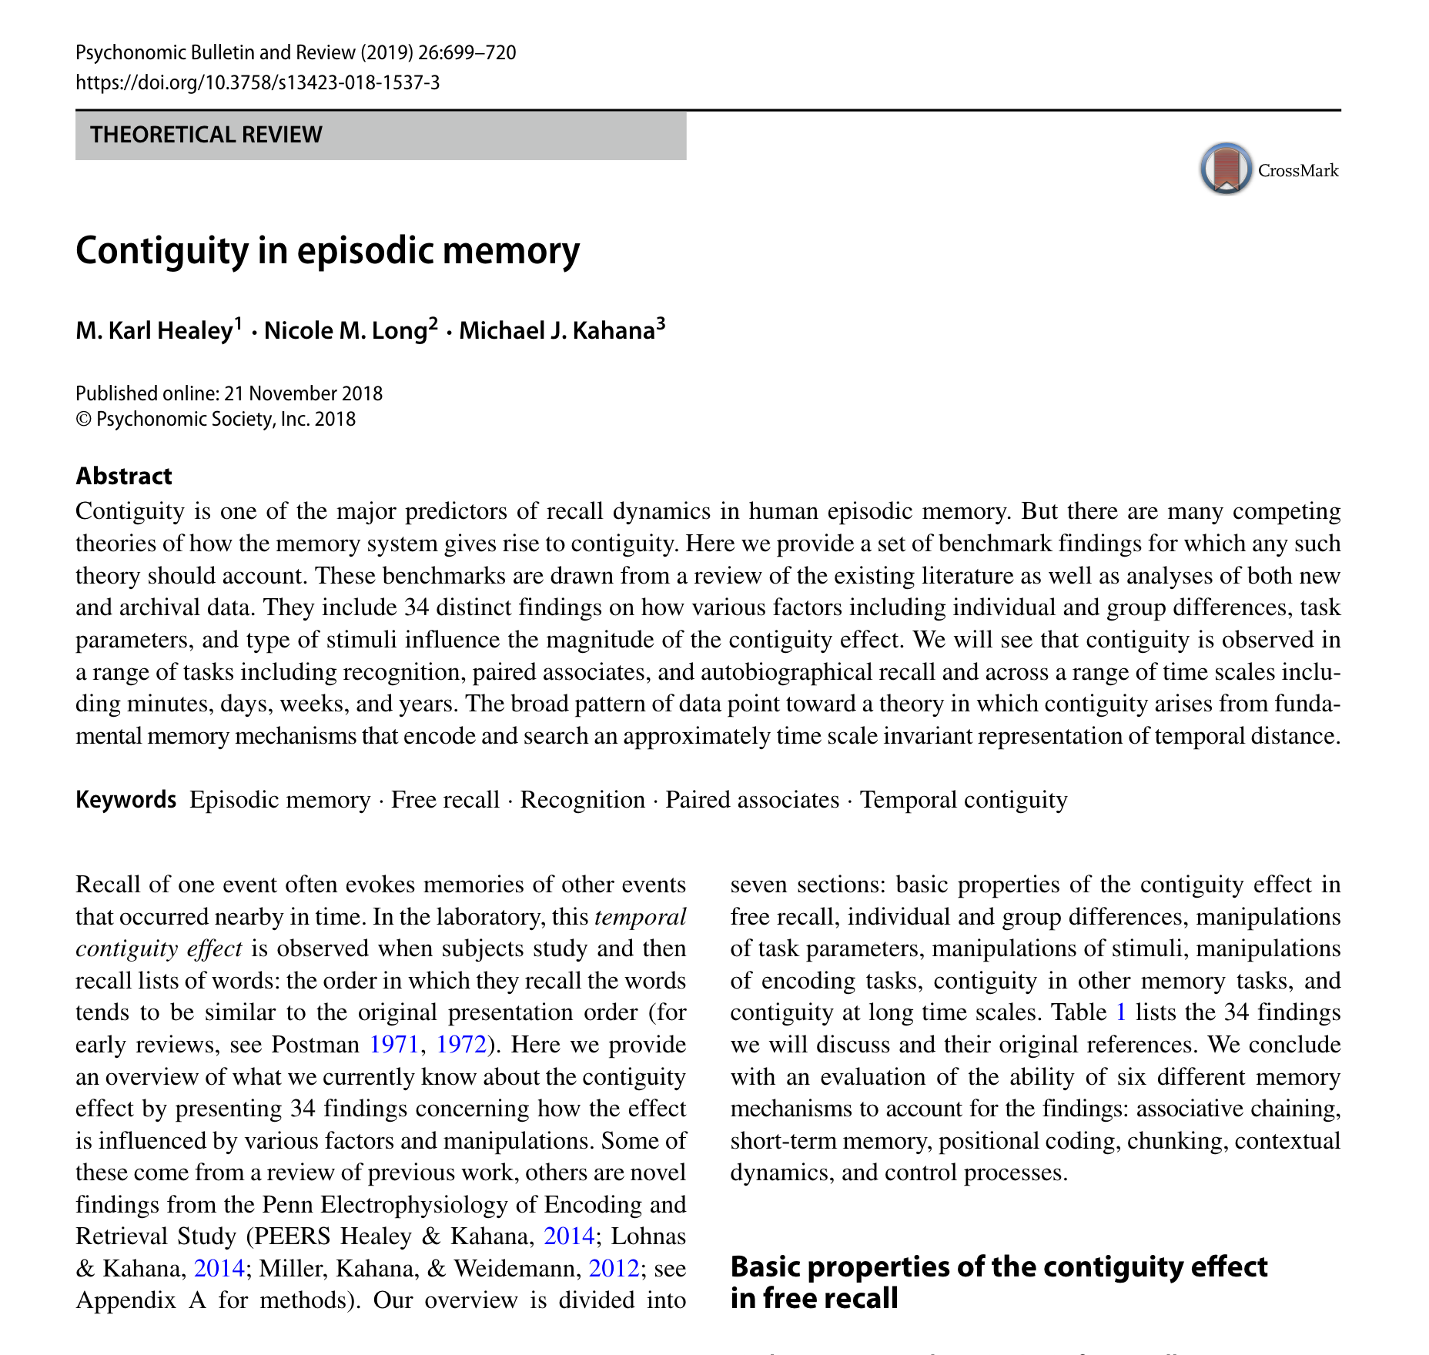
Review Papers

Slide 5
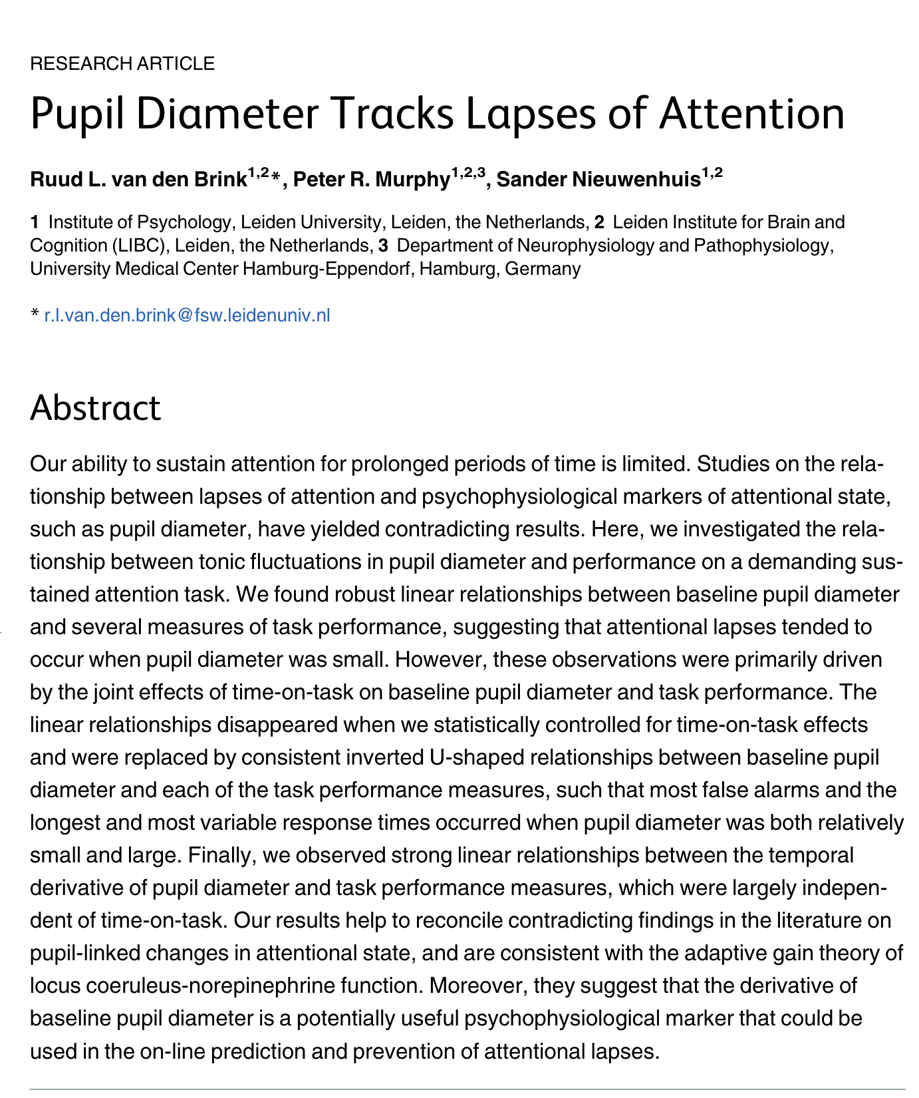
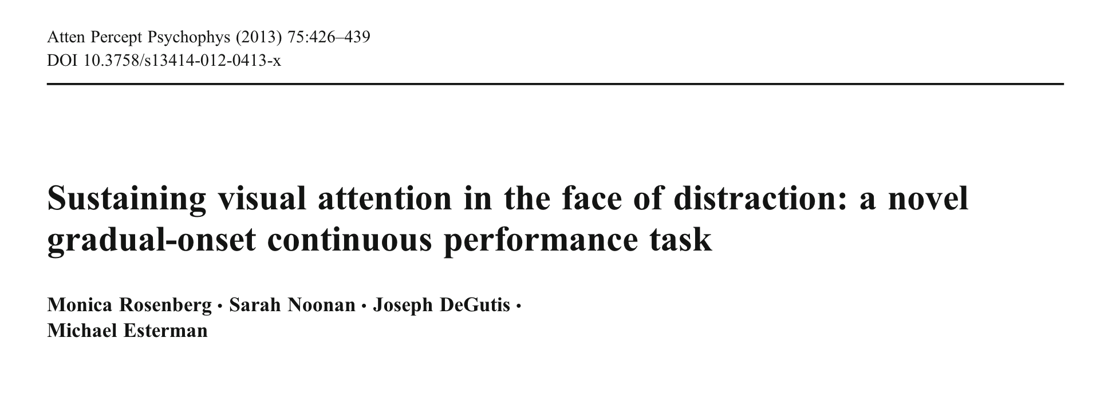
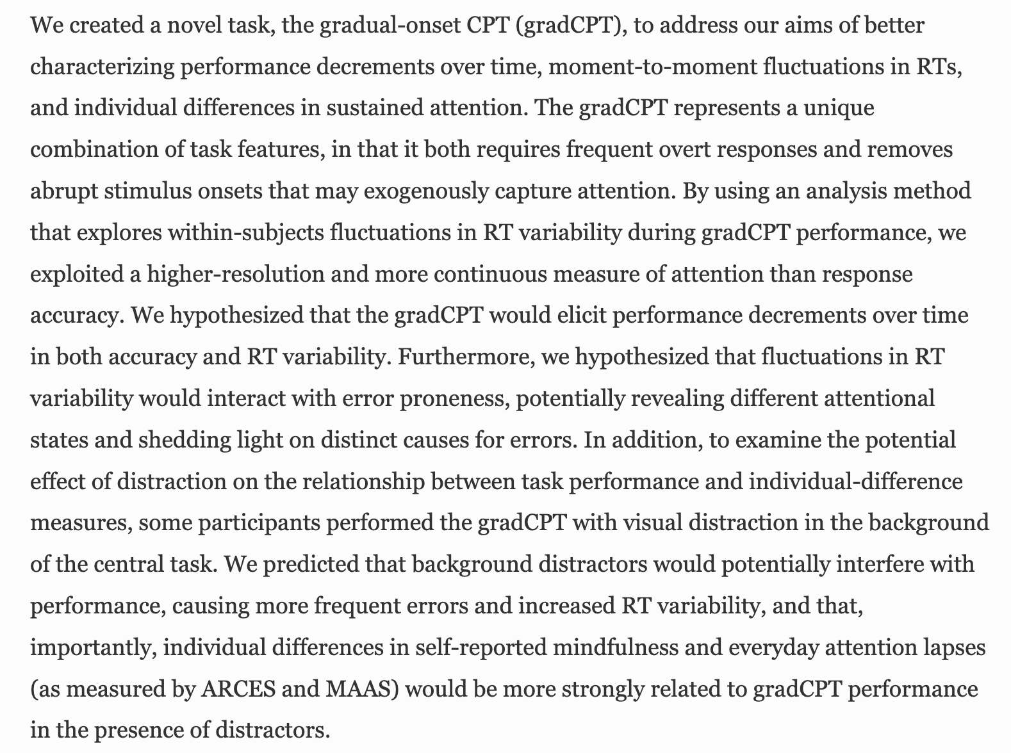
Empirical Papers

Slide 6
Important parts of an empirical paper
Introduction
Big picture question: Big questions in the field that cannot be answered with just one experiment/paper
What informs this current work? Summary of previous literature - What do we know? What are the gaps?
Specific hypothesis What exactly are you testing here?
Notes:
Question:
Big-picture question: bigger questions in the field e.g. how does attention impact memory? Cannot be answered with just one study, but by multiple experiments, and finding converging evidence across them.
What informs this current work? Summary of previous literature, what do we know from it? What are the gaps, what do we still not know?
Specific hypothesis - what exactly are we testing here? Effect of X on Y? What happens when …? Difference between the two conditions?

Slide 7
Important parts of an empirical paper
Methods
Participants Sample (healthy participants, clinical population etc.), age range, etc.
Variables
IV (aka Predictor variable)
DV (aka Outcome variable)
Assessments, tests, or other procedures
Notes:
Methods
Participants - sample (healthy Ps, clinical population, children etc.), age, other measurements of interest
Variables of interest - IV (independent variable or Predictor variable), DV (dependent variable or Outcome variable)
Assessments (questionnaires, surveys), behavioral test in the lab, eye tracking, fMRI, EEG, something else.

Slide 8
Important parts of a paper
Results
Main finding Finding that relates back to the specific hypothesis
Secondary finding Other findings that either talk about secondary variables, or other confounds in the data
Notes:
Results:
Main finding - this should relate back to the specific hypothesis
Secondary finding - other findings that either talk about secondary variables, or other confounds in the data

Slide 9
Important parts of a paper
Discussion
What did they answer?
Any other unanswered questions?
Future work: Resolving confounds, or other ways to test the same hypothesis.
Unanswered questions and future work may not always be explicit in the paper. Think critically about these once you understand the paper.
Notes:
Discussion:
What did they answer?
Any other unanswered questions?
Future work: Resolving confounds, or other ways to test the same hypothesis ?

Slide 10
Take notes as you go
Literature Review Table (recommended)
Literature Review Outline
Paper Notes (organized written/typed notes)
Casual Notes (organize it later)

Slide 11
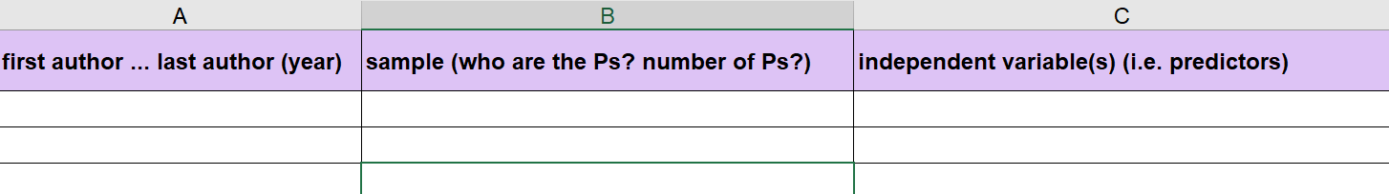
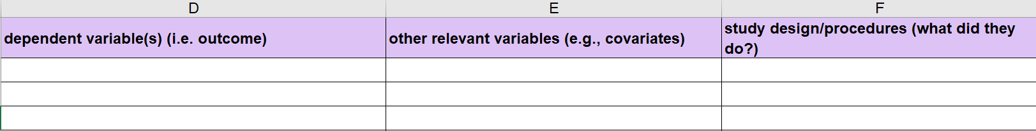
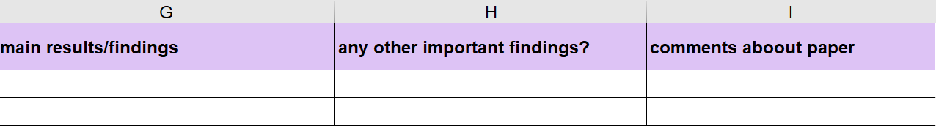
Literature Review Table

Slide 12
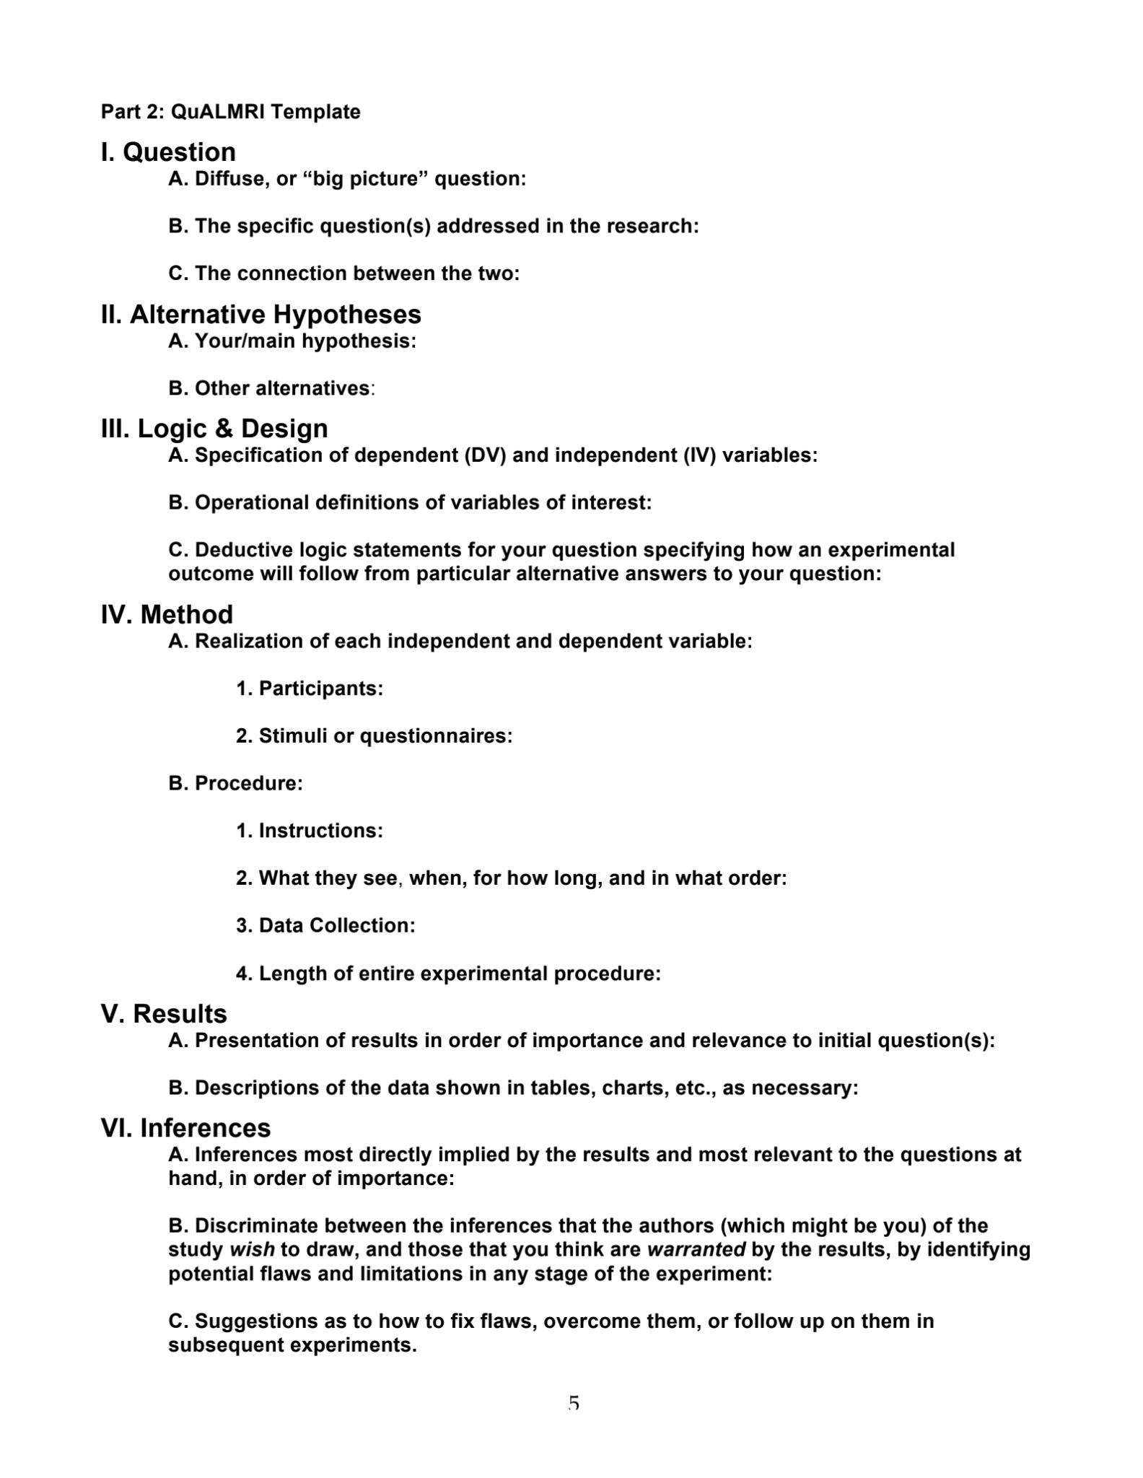
Literature Review Outline
QuALMRI:
Framework adapted from Kevin Ochsner,
based on a scheme devised by Steve Kosslyn
Question,
Alternative hypotheses,
Logic & design,
Method,
Results,
Inferences.

Slide 13
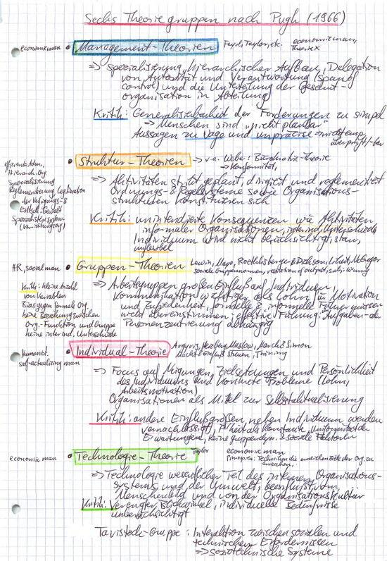
Paper (Hand-written) Notes

Slide 14
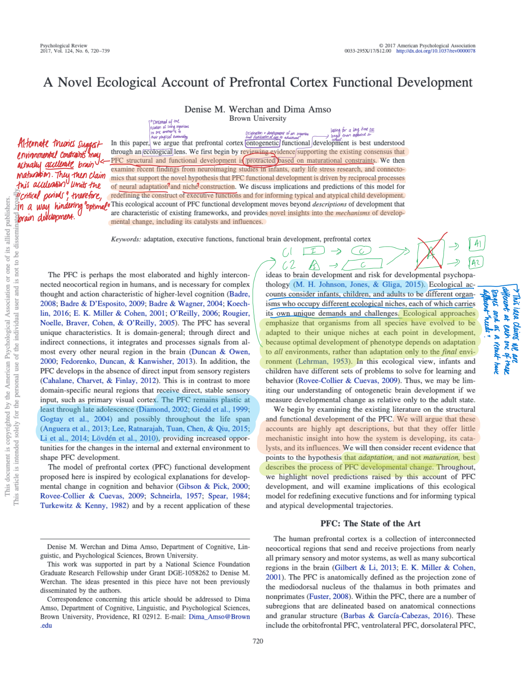
Casual Notes (subsequent organization)

Slide 15
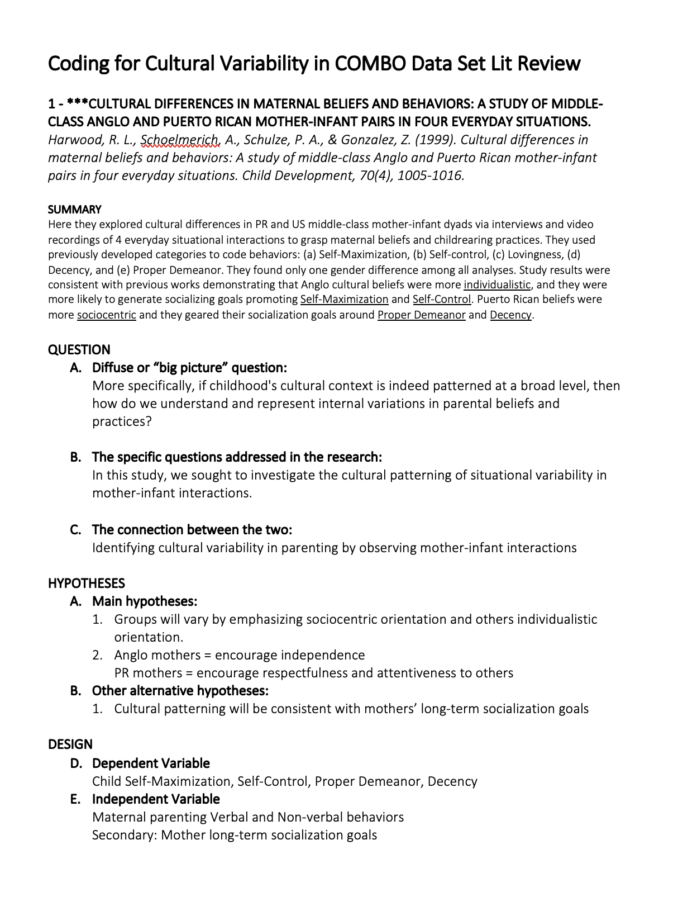
Casual Notes (subsequent organization)

Slide 16
Take notes as you go
Literature Review Table (recommended)
Literature Review Outline
Paper Notes (organized written/typed notes)
Casual Notes (organize it later)

Slide 17
Some tips for reading papers
You don’t have to read everything thoroughly
You don’t have to read in order (can pick and choose based on why you are reading the paper)
Think about the purpose behind reading the paper and tackle it accordingly
Reading as part of the lit review for a research question:
Skim first
Read to get an overall understanding while taking notes (what, why, how)
Reading for Journal Club or a seminar class:
Skim first,
Read while taking notes to get an overall understanding
Read in depth and think through the paper so you can critique it

Slide 18
How I read papers
Read the last paragraph(s) of the introduction to understand the question and the hypotheses
Skim the methods (particularly the figure with the design)
Skim the results (particularly the figure with the main results)
Read the discussion thoroughly, where the results are reviewed in plain language
Go back to methods and results, and re-read to get a complete sense of the paper
Design considerations
Statistical analyses for main findings
Control analyses

Slide 19
Critiquing papers
Was the purpose and importance of the study clear?
Were the hypotheses theoretically sound and clearly stated?
Does the design make sense? Will it allow the authors to test the question? Could it be improved?
Were the proper statistical approaches used to answer the questions?
Were the conclusions drawn appropriate? Could there be any alternate explanations for the results?
How do the results fit in with the broader idea of the paper?
Was the discussion clear? Did it synthesize the paper well? Did it make sense of contradictory or non-significant findings?
http://labs.psychology.illinois.edu/~lyubansk/Method/rmcritique.htm

